Slide 1
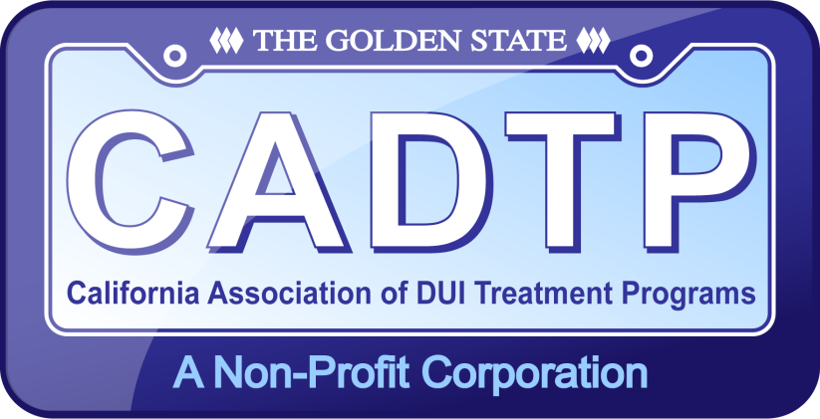


Best Practices For California Licensed Driving Under the Influence (DUI) Program Providers
Best Practice
Document Overview
for
Driving Under the Influence (DUI) Advisory Group
March 2 2015

Slide 2

Presenters
Craig French
Twin Palms Recovery Center, Los Angeles County
CADTP Board of Directors, Chair
craigfrench54@gmail.com
Laura Kantorowski, Ph.D. Bay Area Community Resources, Marin & Napa Counties
CADTP Board of Directors
lkantorowski@bacr.org
Sam Beasley
Prevention Education Program, Inc. Butte and Glenn Counties
Alcohol Recovery Center, San Joaquin County
CADTP Board of Directors
Sam_beasley@comcast.com
Notes:
Craig

Slide 3
CADTP Organizational Member Contributors:
ABC Traffic Safety Program, Cherine Child
Center for Counseling & Education, Wendie Warwick
Episcopal Community Services, Stacie Perez
OHS DUI Program, Teri Kerns
Prevention Education Program, Suzanne Lorenz
Alcohol Recovery Center, Sam Beasley
San Diego State University, Georgi Distefano
Notes:
Craig The best practice document was a collaboration. The committee chair Teri Kerns sent an e-mail to all CADTP organizational members for interest to join committee, the above are the responders. Each took a section and the committee agreed upon content to ensure generic enough for implementation.

Slide 4
Best Practice Document -Table of Contents
Introduction
CADTP History
CADTP DUI Program Philosophy
Continuous Quality Improvement
DUI Program Structure of Services
Substance Use Assessments and Program Sobriety
DUI Education
DUI Counseling
Program Fees
Leave of Absence
Transfers
Program Completions
Program Dismissals
Client Records and Confidentiality
Court Referral and Tracking
Certification as an Alcohol and Other Drug Abuse Counselor (CAODC)
Notes:
Sam The committee choose the topics they felt were the most important to cover in the first edition of the DUI program best practice.

Slide 5
Introduction: Intent of the Best Practice
The intent of this document is to present a set of suggested best practices for licensed DUI Treatment Programs to follow in order to provide quality services and regulatory compliance, resulting in safer communities and healthier individuals at no cost to the tax-payer.
CADTP does not intend for this to serve as a program protocol or operations manual, but hopes that it may become a set of suggested standards for use in creating each providers’ own DUI program protocol.
We encourage all people who work in our field to use this guide as a roadmap to raise DUI treatment standards to the highest level.
Notes:
Sam It is important that the intent of the document is clear and the best practices are a set of suggested practices

Slide 6
DUI Treatment in the Continuum of Care
SAMHSA’s Summit on Recovery
There are many pathways to recovery. Individuals are unique with specific needs, strengths, goals, health attitudes, behaviors, and expectations for recovery. Pathways to recovery are highly personal, and generally involve a redefinition of identity in the face of crisis, or a process of progressive change.
Furthermore, pathways are often social, grounded in cultural beliefs or traditions, and involve informal community resources, which provide support for sobriety. The pathway to recovery may include one or more episodes of psychosocial and/or pharmacological treatment.
For some, recovery involves neither treatment nor involvement with mutual aid groups. Recovery is a process of change that permits an individual to make healthy choices and improve the quality of her or his life.
Notes:
Sam The DUI treatment field is a part of the continuum of care. The DUI programs assist the clients in their process of change to make healthy choices and improve the quality of her or his life.

Slide 7

Summary Definition of DUI Treatment Services
California’s State Licensed Driving Under the Influence (DUI) Programs provide outpatient substance use treatment at no public cost.
Our focus is on reducing DUI recidivism statewide and improving public safety.
Our goal is to help individuals convicted of driving under the influence understand the danger their behavior poses to themselves, as well as their communities, and the negative impact their use has on their family members, their employment and our society.
Referrals are made to appropriate available community resources when:
the assessment indicates,
the individual requests more intensive treatment for their alcohol and other drug use,
or assessor determines the client might potentially benefit from services beyond the scope of practice of the counselor and the DUI program.
Notes:
Sam It is important that the definition of DUI programs are well defined and the goal of the DUI treatment.

Slide 8

CADTP DUI Program Philosophy
It is not our intent to restate the regulations, but rather present our collective agreement of the best practices and provide information to create a meaningful treatment episode which results in behavioral change, and reduced recidivism, impacting the client, family, social and community safety.
DUI Programs are essential in protecting public safety in the State of California. A series of DMV Research and Development studies completed from 1987 through 1996 show that the combined use of license suspension and the DUI Program is more effective in reducing recidivism and DUI crashes than use of jail time alone.

Slide 9
Best Practice Document -Table of Contents
Introduction
CADTP History
CADTP DUI Program Philosophy
Continuous Quality Improvement
DUI Program Structure of Services
Substance Use Assessments and Program Sobriety
DUI Education
DUI Counseling
Program Fees
Leave of Absence
Transfers
Program Completions
Program Dismissals
Client Records and Confidentiality
Court Referral and Tracking
Certification as an Alcohol and Other Drug Abuse Counselor (CAODC)
Notes:
The committee choose the topics they felt were the most important to cover in the first edition of the DUI program best practice.

Slide 10
Best Practice Document Structure
Each topic is presented in 3 parts:
Philosophy
Information
Best Practice
Today we will preview Continuous Quality Improvement as an example
Notes:
Sam

Slide 11
Continuous Quality Improvement
Philosophy
In order to ensure the highest quality of services provided by a State licensed DUIP, every provider would benefit by having a Continuous Quality Improvement plan built into their policies, procedures and into the overall culture of their organization.
Continuous Quality Improvement enables programs to address problematic issues in their programs and to also set goals and look for areas where their services can be improved.
A quality assurance plan, hiring/retaining and training qualified staff, providing supervision to the counseling staff, chart auditing, and obtaining client feedback are all aspects of Continuous Quality Improvement.
Notes:
Laura

Slide 12
Continuous Quality Improvement
Information
California Code of Regulations, Title 9 outlines both the minimum requirements for staff qualifications and functions (Section 9846), and the organization and maintenance of client records (Section 9866).
CADTP takes Continuous Quality Improvement seriously as it ensures the very best DUI treatment possible for the clients that are served and increases the stability of the licensed DUI program itself.
Notes:
Laura

Slide 13
Continuous Quality Improvement
Best Practices
1. Quality Assurance Plan:
Identifies measurable goals and makes adjustments to the goals as they are achieved and/or changed
Is developed and modified on an on-going basis
Annually set performance goals
2. Hiring and Training Qualified Staff:
Offering in-house continuing education units (CEU’s) to the DUI provider staff. Becoming a CADTP CEU provider is one way to accomplish this.
Retaining a Clinical Supervisor on staff or as a consultant to train counselors and/or review more challenging cases
Developing a solid Internship program
Notes:
Laura

Slide 14
Continuous Quality Improvement
3. Supervisor Role:
Coach and/or clinically supervise their subordinates on a regular schedule
Give clear expectations to the staff that they supervise
Ensure that there is an adequate ratio of supervisors to counselors to provide appropriate supervision
Supervisor audits charts and observes and provides feedback for the delivery of direct client service activities
Utilize the provider HR department and/or HR policies
Notes:
Laura

Slide 15
Continuous Quality Improvement
4. Chart Auditing System to ensure compliance with Title 9 regulations:
Self Audits
Peer Audits
Administrative Audits to ensure completion of necessary documents
Supervisor Audits to ensure quality of clinical documentation
5. Client Feedback:
Implement a client satisfaction survey system
Share the results of the provider surveys with the provider staff and other stakeholders
Make program improvements based on information received from the surveys
Notes:
Laura

Slide 16
Continuous Quality Improvement
6. Quality Assurance and Goal Setting:
Every DUI program would benefit by implementing a quality assurance plan and setting goals to address their specific program needs. Measurable goals may include:
Increased referrals
Increased percentage of clients who are referred to successfully enroll
Increased number of clients who are enrolled to successfully complete program services
Decreased chart deficiencies
Increased number of certified counselors
Notes:
Laura

Slide 17
Next Steps for the Best Practice Document
The Best Practice document will be distributed at the Best Practice CEU Training, CADTP Spring Forum May 20 & 21 2015
CADTP Organizational Members will be notified when the Best Practice document is available to them
The Best Practice will be available on the CADTP Store – coming soon
Feedback will be gathered and the document will be updated at next printing
Notes:
Craig

Slide 18
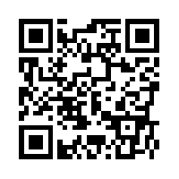
Thank you
Bookmark the CADTP website www.cadtp.org
Like us on Facebook
Follow us @cadtp

Slide 19

Mark your calendar for the CADTP Spring Forum
Hilton Embassy Suites, La Quinta, CA
May 19 2015 @ 6:30 – Organizational Membership Meeting
May 20 2015 - Forum Day One (will include Ethics)
May 21 2015 – Forum Day Two (will include Best Practice)
Registration will open in March

